Slide 1
Anti-Sleep alarm with Alcohol & flame detector
IS 1900 (Business Project)
Group No :08

Slide 2
Group Members
 | Name(Write your name with Initials | Reg. No:
Group Leader | Raguraj S. | 205080K
Member 1 | Sagini N. | 205092A
Member 2 | Kaneshan T. | 205048V
Member 3 | Ishvini A. | 205039U

Slide 3
Outline
Problem in brief
Project aim and Objectives
Proposed Solution – System Diagram
Circuit Diagram
Schematic Diagram
PCB Design
Silk Screen
3D Diagram
Animation Video
Resource Required
Testing and Implementation
Cost Estimation
Reference Links
Individual Progression

Slide 4
Problem in brief
Drunk and drive
Sleep related accidents
Fire accidents

Slide 5
Project Aim & Objectives
Aim:
The aim of our project is reducing the accident that caused by drowsiness, drunk driving and fire.
Objectives:
To check whether, driver is sleeping or not.
To check whether, driver has drunk or not.
To reduce fire-based accidents.
To inform to his well wishers about unstable situations.
To identify the current location of vehicle in the unstable situations.

Slide 6
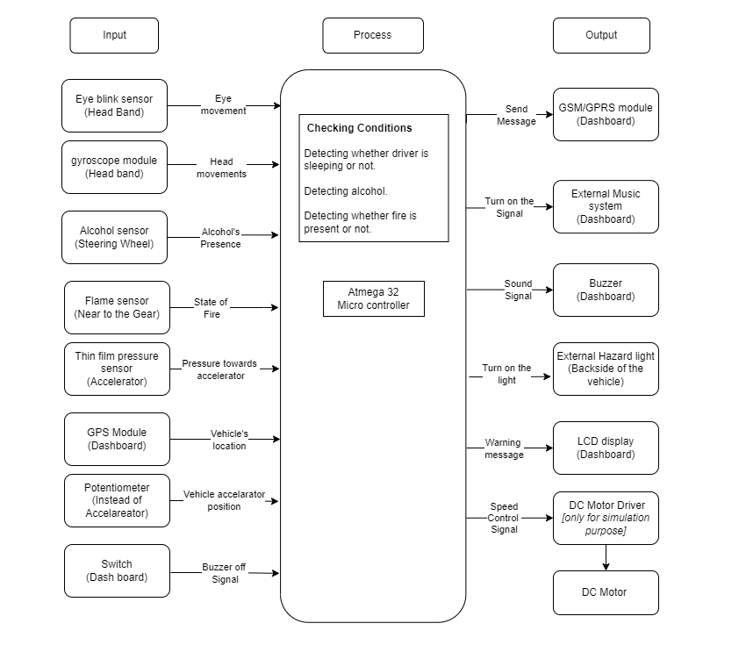
Proposed Solution – System Diagram

Slide 7
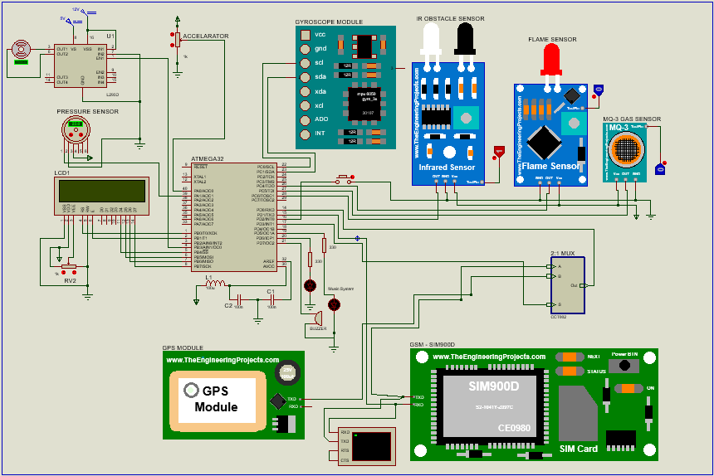

Circuit Diagram

Slide 8
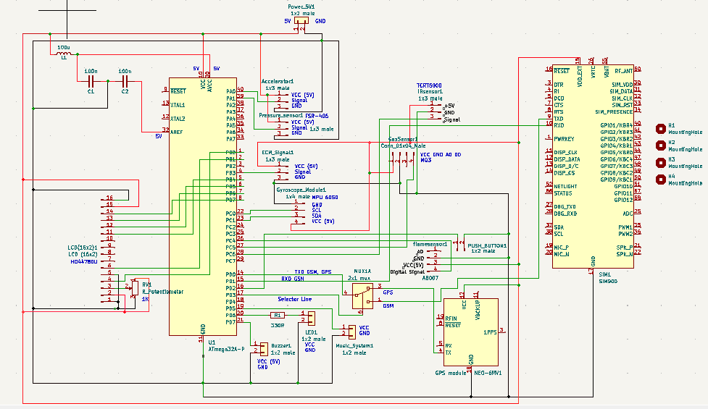
Schematic Diagram

Slide 9
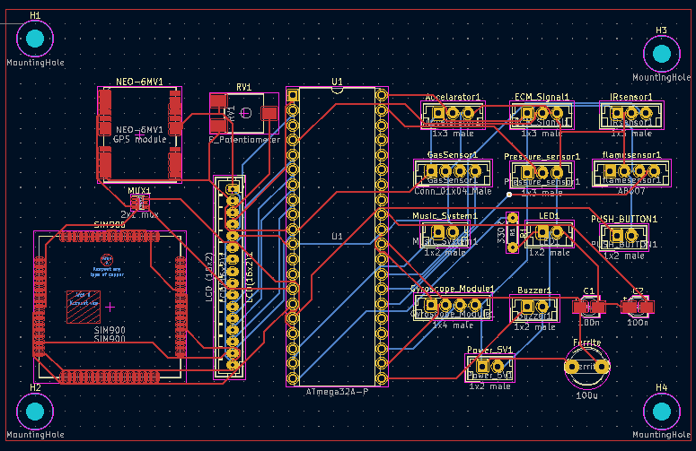
PCB Design

Slide 10
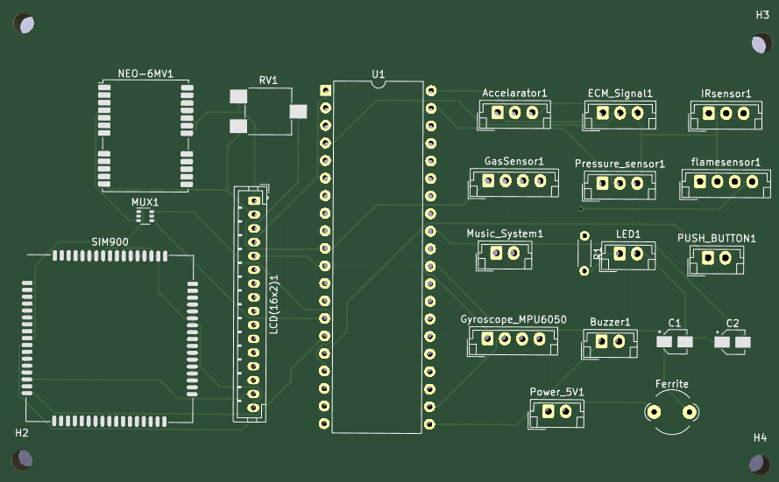
Silkscreen

Slide 11
3D Diagram

Slide 12
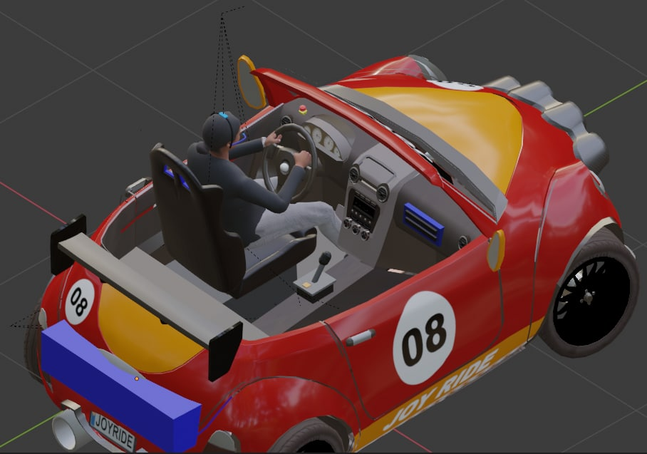
1: GPS Module, GSM/ GPRS Module and LCD
2: External Music System
3: Buzzer and Switch
4: Alcohol Sensor
5: Head band with IR Sensor and Gyroscope Module
6: Flame Sensor
7: External Hazard Light
5
3
4
2
1
6
7

Slide 13
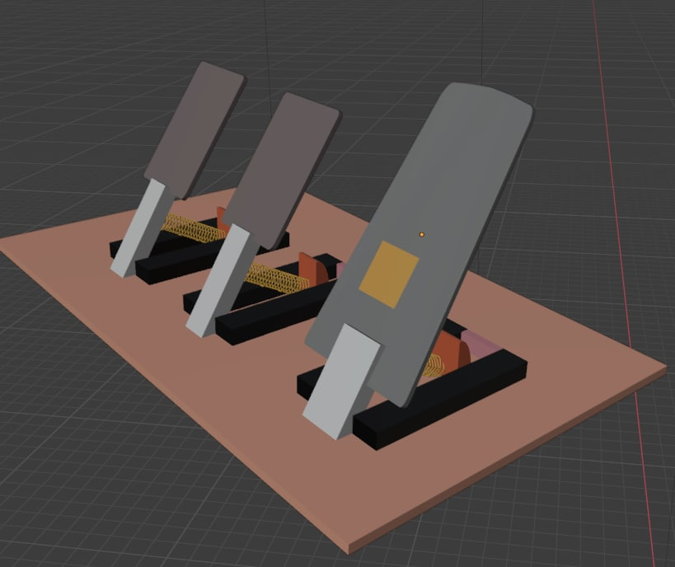
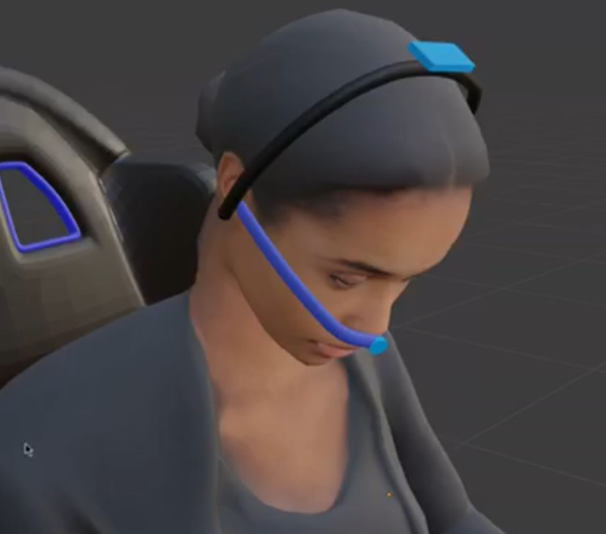
10
8
9
8: Pressure Sensor
9: IR Sensor
10: Gyroscope Module

Slide 14

When detecting the fire…

Slide 15

When sensing the Alcohol…

Slide 16
Eye blinking sensor and Headband

Slide 17
Resource Required
Software:
Atmel Studio, Proteus, Blender, Kicad
Hardware:
Sensors: Alcohol Sensor, Eye blinking sensor, Flame sensor, Thin film pressure sensor
Microcontroller: Atmega32
GSM/GPRS Module and GPS Module
Gyroscope module
Buzzer ,External Hazard light
DC Motor and DC Motor Module
LCD display
Potentiometer
External music system

Slide 18
Testing and Implementation

Slide 19
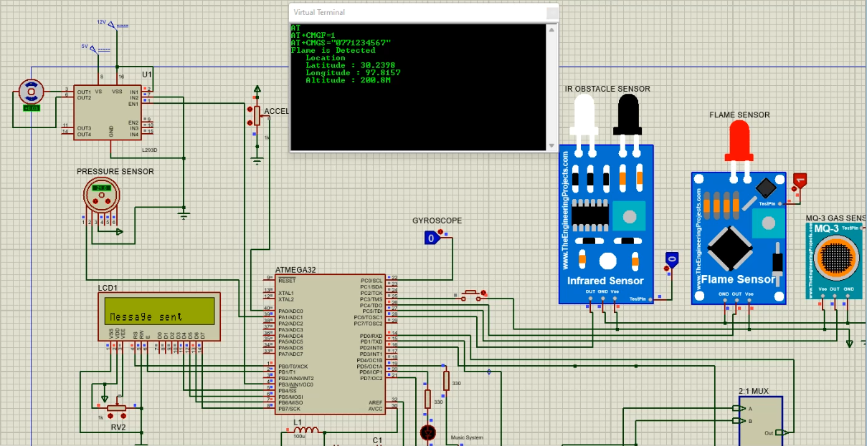
When flame is detected

Slide 20
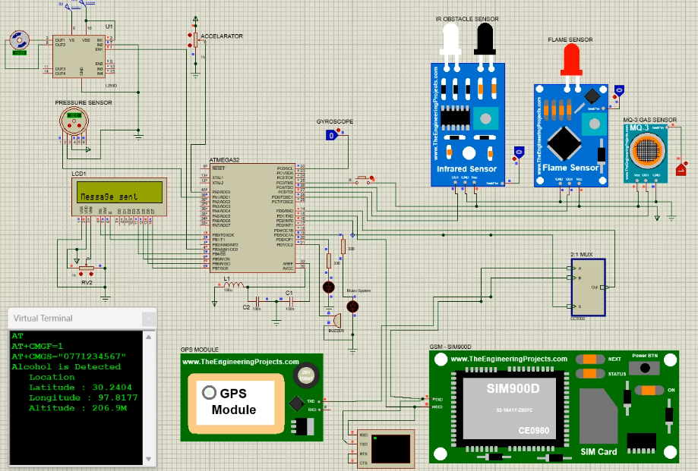
When alcohol is detected

Slide 21
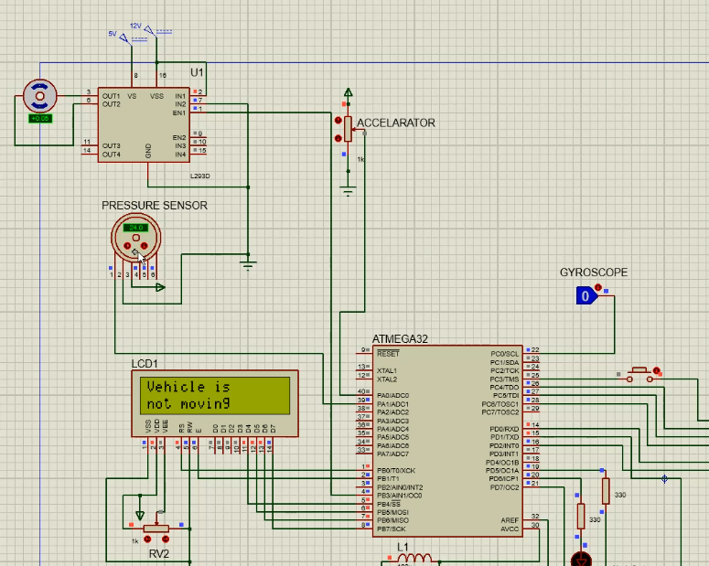

When vehicle is not moving and moving

Slide 22
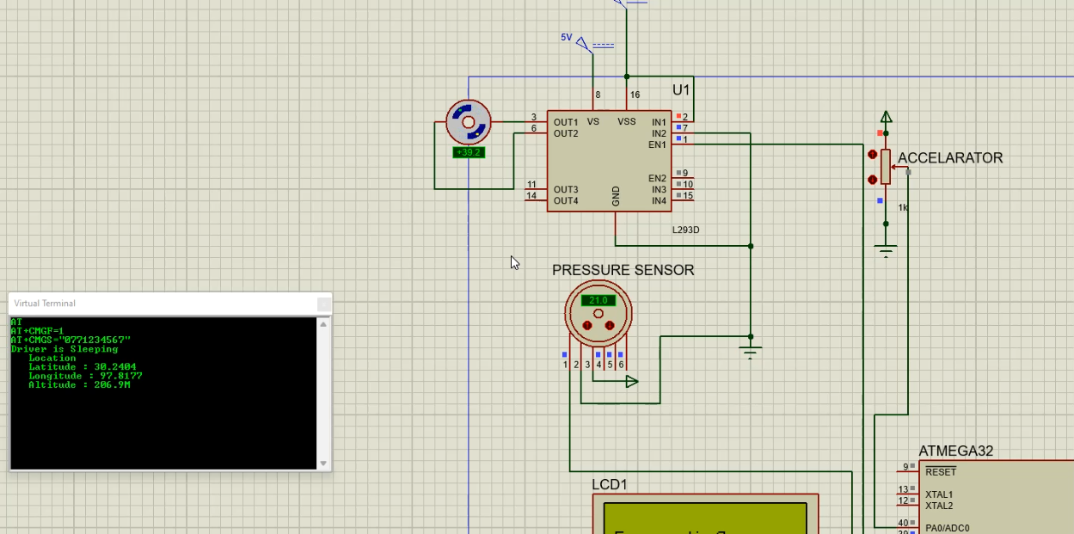
When driver is sleeping

Slide 23
Cost Estimation
Hardware specifications | Cost
Atmega32-L Microcontroller | 540.00
MQ-3 Alcohol Ethanol Gas Sensor | 395.00
Eye blinking sensor | 150.00
Potentiometer | 10.00
DC Motor | 400.00
Flame sensor | 200.00
Thin-film pressure sensor | 725.00
Gyroscope module | 660.00
Buzzer | 80.00
Radio system/ MP3 player | 1600.00
GPS module | 1600.00
GSM/GPRS Module | 2220.00
LCD display | 550.00
Hazard light(LED) | 10.00
Total cost | 9140.00

Slide 24
Reference links
[1] | “BMW model upgrade measures taking effect from the summer of 2013,” Bmwgroup.com. [Online]. Available: https://www.press.bmwgroup.com/global/article/detail/T0141144EN/bmw-model-upgrade-measures-taking-effect-from-the-summer-of-2013. [Accessed: 30-Nov-2021].
[2] | “Audi Media Center,” Audi-mediacenter.com. [Online]. Available: https://www.audi-mediacenter.com/en. [Accessed: 30-Nov-2021].
[3] | “2016 Nissan Maxima ‘4-Door Sports Car’ makes global debut at New York International Auto Show,” Nissannews.com, 02-Apr-2015. [Online]. Available: https://usa.nissannews.com/en-US/releases/2016-nissan-maxima-4-door-sports-car-makes-global-debut-at-new-york-international-auto-show. [Accessed: 30-Nov-2021].
[4] | P. by:NeilNie, “Hacking the accelerator — controlling the speed using an Arduino,” Neilnie.com, 17-Jan-2018. [Online]. Available: https://neilnie.com/2018/01/17/modifying-the-acceleration-system-control-the-speed-of-the-golf-cart-using-an-arduino/. [Accessed: 30-Nov-2021].
[5] | “Guide to troubleshooting photocell sensors,” Sciencing.com, 30-Mar-2011. [Online]. Available: https://sciencing.com/guide-troubleshooting-photocell-sensors-8142366.html. [Accessed: 30-Nov-2021].
[6] | M. Abinaya, K. Adithya, B. Kalaivani, P. M. Lavanya, K. Kumaran, and M. Sowmiya, “Drowsiness Detection using Ir sensor,” European Journal of Molecular & Clinical Medicine, vol. 7, no. 8, pp. 2106–2114, 2020.
[7] | Last Minute Engineers, “Send Receive SMS & Call with SIM900 GSM Shield & Arduino,” Lastminuteengineers.com, 15-Nov-2018. .
[8] | S. Z. Nasir, “GPS library for Proteus,” Theengineeringprojects.com, 22-Dec-2015. [Online]. Available: https://www.theengineeringprojects.com/2015/12/gps-library-proteus.html. [Accessed: 30-Nov-2021].
[9] | M. Al-Yassary, K. Billiaert, G. S. Antonarakis, and S. Kiliaridis, “Evaluation of head posture using an inertial measurement unit,” Sci. Rep., vol. 11, no. 1, p. 19911, 2021.
[10] | M. (Max), “The ADC of the AVR,” Wordpress.com, 20-Jun-2011. [Online]. Available: https://maxembedded.wordpress.com/2011/06/20/the-adc-of-the-avr/comment-page-1/. [Accessed: 30-Nov-2021].
[11] | jojo, “DC motor speed control using PWM in AVR Atmega32,” Circuitstoday.com, 24-Mar-2017. [Online]. Available: https://www.circuitstoday.com/dc-motor-speed-control-using-pwm-avr. [Accessed: 30-Nov-2021].
[12] | M. Tresanchez, T. Pallejà, and J. Palacín, “Optical mouse sensor for eye blink detection and pupil tracking: Application in a low-cost eye-controlled pointing device,” J. Sens., vol. 2019, pp. 1–19, 2019.
[13] | “DataSheets,” Uom.lk. [Online]. Available: https://dms.uom.lk/s/QEdpCEiWiTknc7S. [Accessed: 08-Dec-2021].

Slide 25
Reference Links
[14] | “MPU6050 Accelerometer and Gyroscope Module,” Components101.com. [Online]. Available: https://components101.com/sensors/mpu6050-module. [Accessed: 13-Dec-2021].
[15] | “Final Video,” Uom.lk. [Online]. Available: https://dms.uom.lk/s/Ei9ap4ytgHE3txd. [Accessed: 13-Dec-2021].

Slide 26
Individual Progress and Simulation

Slide 27
Thank You
Questions

